Slide 1
Lesson objective
Need whiteboard markers
Title: Squared numbers and similar expressions
Aim:
Estimate the value of square roots
Prove similar expressions through substitution
Plan:
Daily review
  Words to expressions
Square roots
Substitution

Slide 2
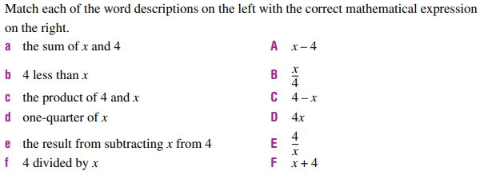
Review

Slide 3
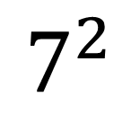

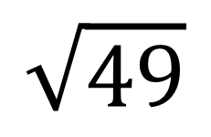
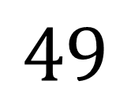
$$7^{2}$$
$$7^{}$$
$$49$$
$$\sqrt{49}$$

Slide 4
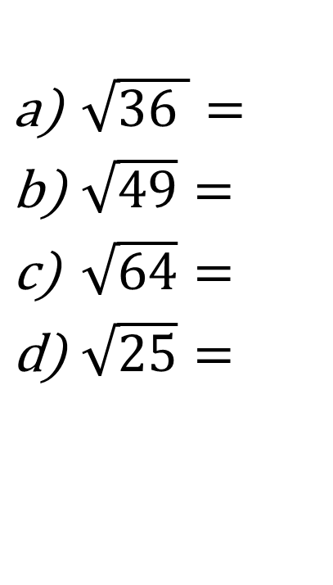
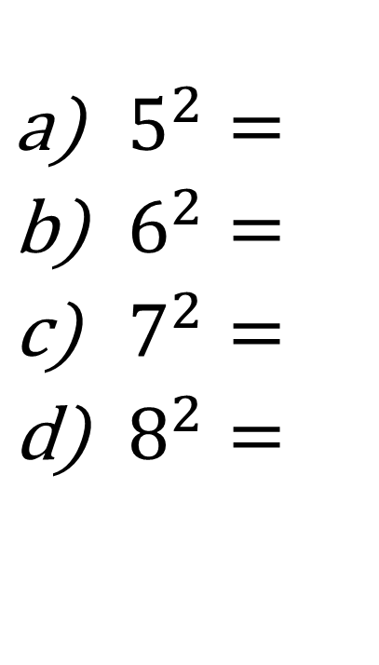

Calculators (exercise books)
$5^{2}=$
$6^{2}=$
$7^{2}=$
$8^{2}=$
$\sqrt{36 }=$
$\sqrt{49}=$
$\sqrt{64}=$
$\sqrt{25}=$
Without a calculator estimate $\sqrt{30}≈$

Slide 5

Whiteboards – estimate the value…
$\sqrt{50 }$
$\sqrt{99}$
$\sqrt{22}$

Slide 6
The word is
Equivalent
Equal in value, amount or meaning
Therefore, Equivalent expressions would mean……
2 (or more) Expressions that are equal

Slide 7
How can we test if they are equivalent?
Substitution
Replace a pronumeral with a value and solve
Are these expression equivalent?
3x + 6y 3(x + 2y)

Slide 8
Determine if these are equivalent expressions
Exercise books
2x + 3 AND x + 2
3e – 4 AND 2e – 1
4r + 16 AND 2(2r + 8)

Slide 9
Expressions with indices
B and A grade level questions:
THINK: how could I write this in numbers?
Sam started with 4 hats, every year the number of hats doubles. So, after 2 years Sam has 8 hats, after 3 year = 16 hats. How many hats will Sam have after 7 years?
What does this look like just using numbers?

Slide 10
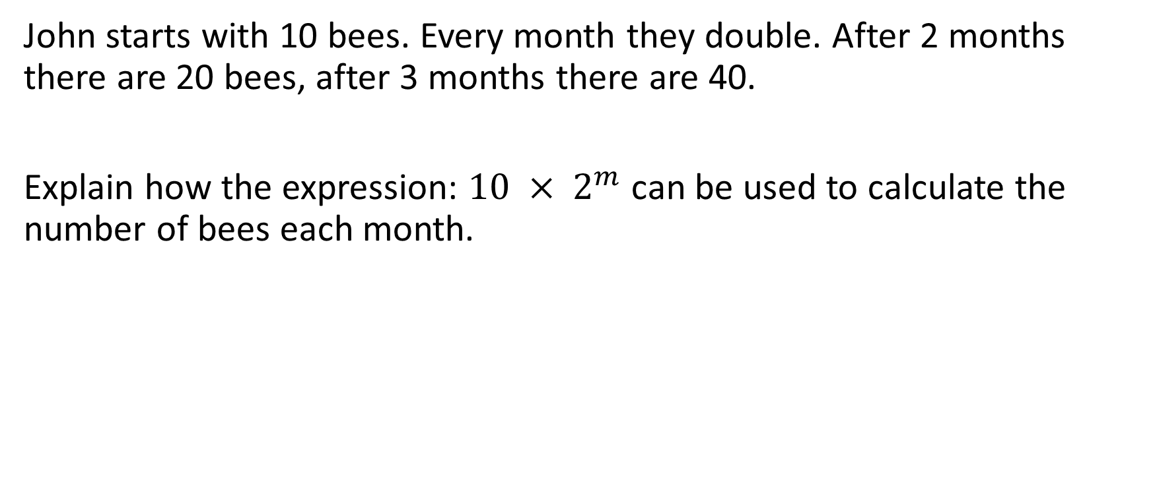
THINK: what do the numbers represent?
John starts with 10 bees. Every month they double. After 2 months there are 20 bees, after 3 months there are 40.
Explain how the expression: $10 × 2^{m}$ can be used to calculate the number of bees each month.

Slide 11
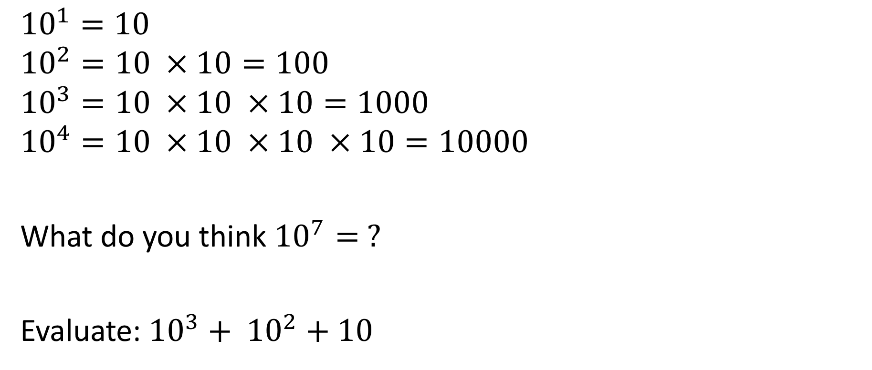
Powers of 10
$${10}^{1}=10$$
$${10}^{2}=10 ×10=100$$
$${10}^{3}=10 ×10 ×10=1000$$
$${10}^{4}=10 ×10 ×10 ×10=10000$$
What do you think ${10}^{7}= ?$
Evaluate: ${10}^{3}+ {10}^{2}+10$

Slide 12
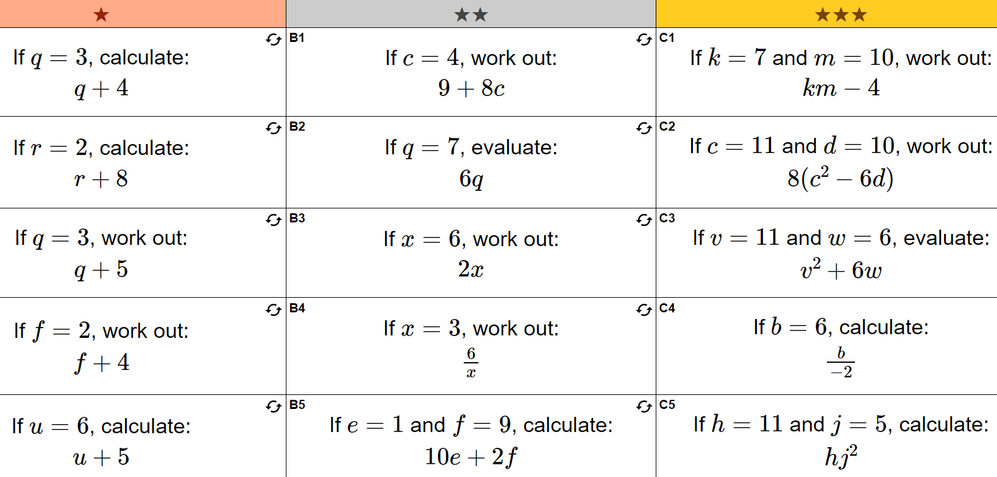
Substitution practice

Slide 13
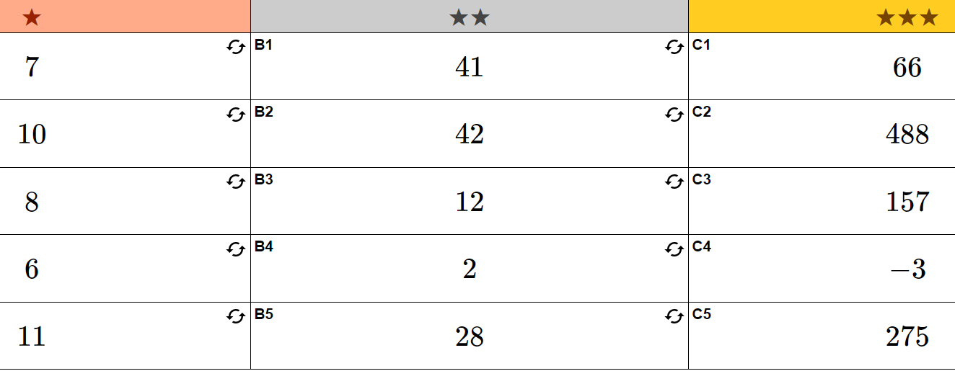

Slide 14
Individual practice
Page 215
Questions:
1 – 3 and 7 – 10 and 12
Challenge question 14

